Slide 1

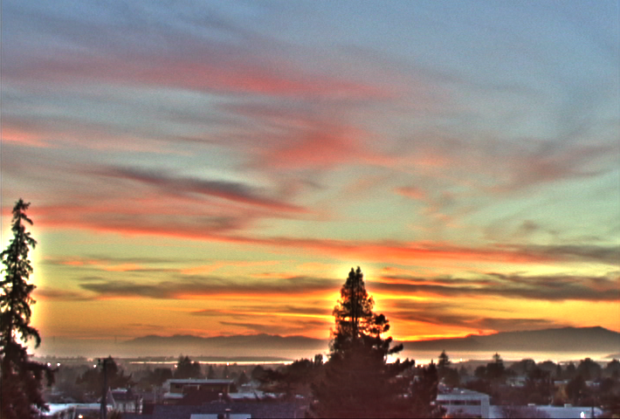
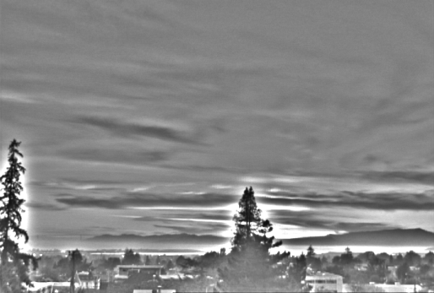
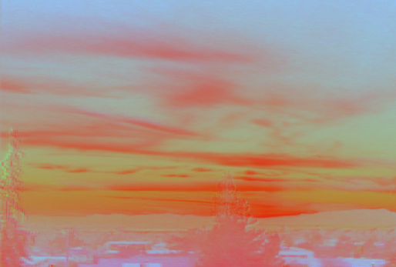
The halo nightmare
For strong edges
Because they contain high frequency
Low-freq.
Reduce low frequency
High-freq.
Color

Slide 2
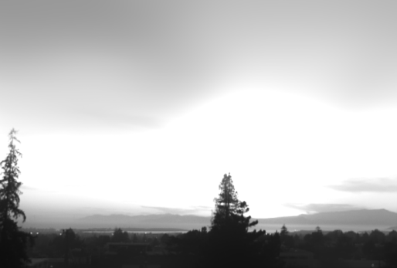
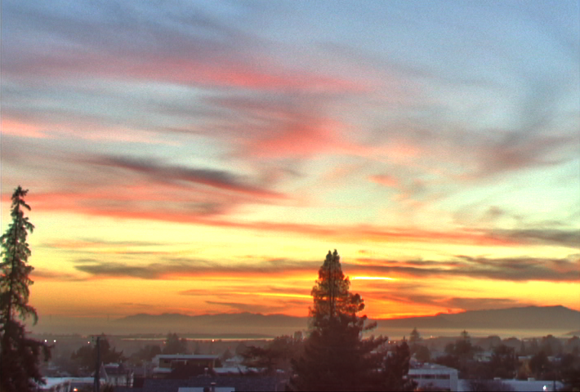
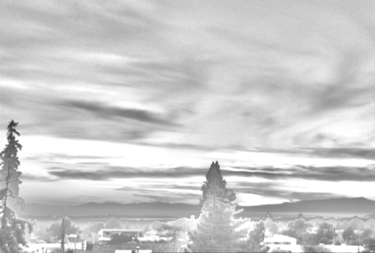

Bilateral filtering to the rescue
Large scale = bilateral (log intensity)
Detail = residual
[Durand & Dorsey 2002]
Large-scale
Output
Detail
Color

Slide 3




Hard to Compute
Nonlinear
Complex, spatially varying kernels
Cannot be pre-computed
Brute-force implementation is slow > 10min

Slide 4
Brute-force Implementation
For each pixel p
For each pixel q
Compute
8 megapixel photo: 64,000,000,000,000 iterations!
V E R Y S L O W !
More than 10 minutes per image

Slide 5
Bilateral filtering
Gaussian smoothing
Bilateral filtering
Input

Slide 6
图像基本操作(V)
Mingli Song
College of Computer Science, Zhejiang University
brooksong@zju.edu.cn
http://person.zju.edu.cn/msong/

Slide 23
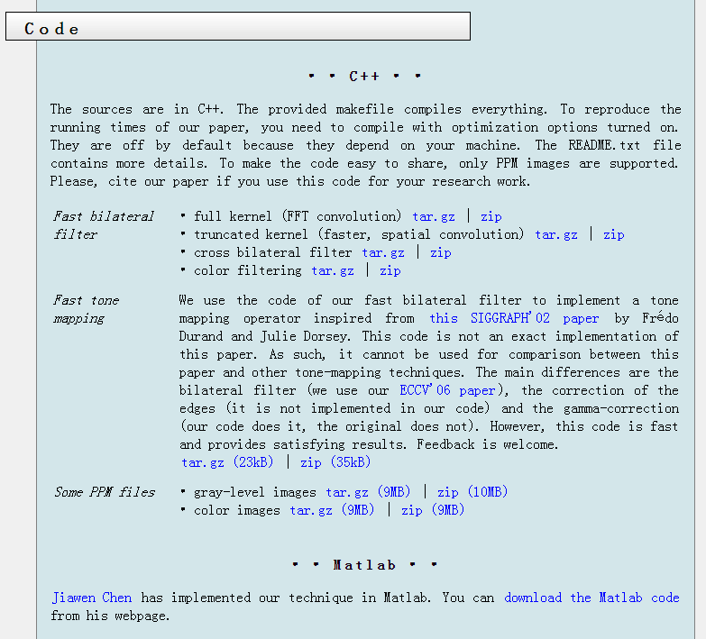
http://people.csail.mit.edu/sparis/bf/#code

Slide 24
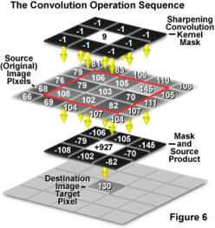
图像基本操作(V)
Mingli Song
College of Computer Science, Zhejiang University
brooksong@zju.edu.cn
http://person.zju.edu.cn/msong/

Slide 25
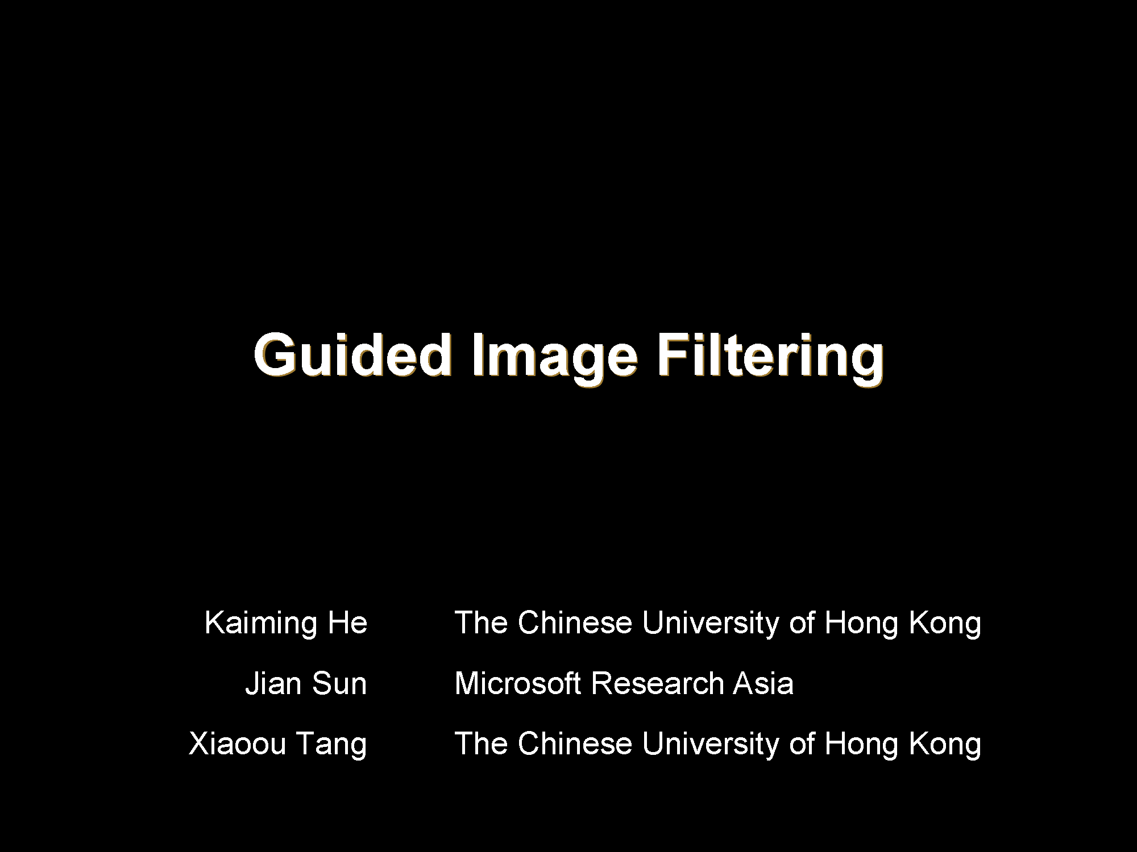

Slide 26
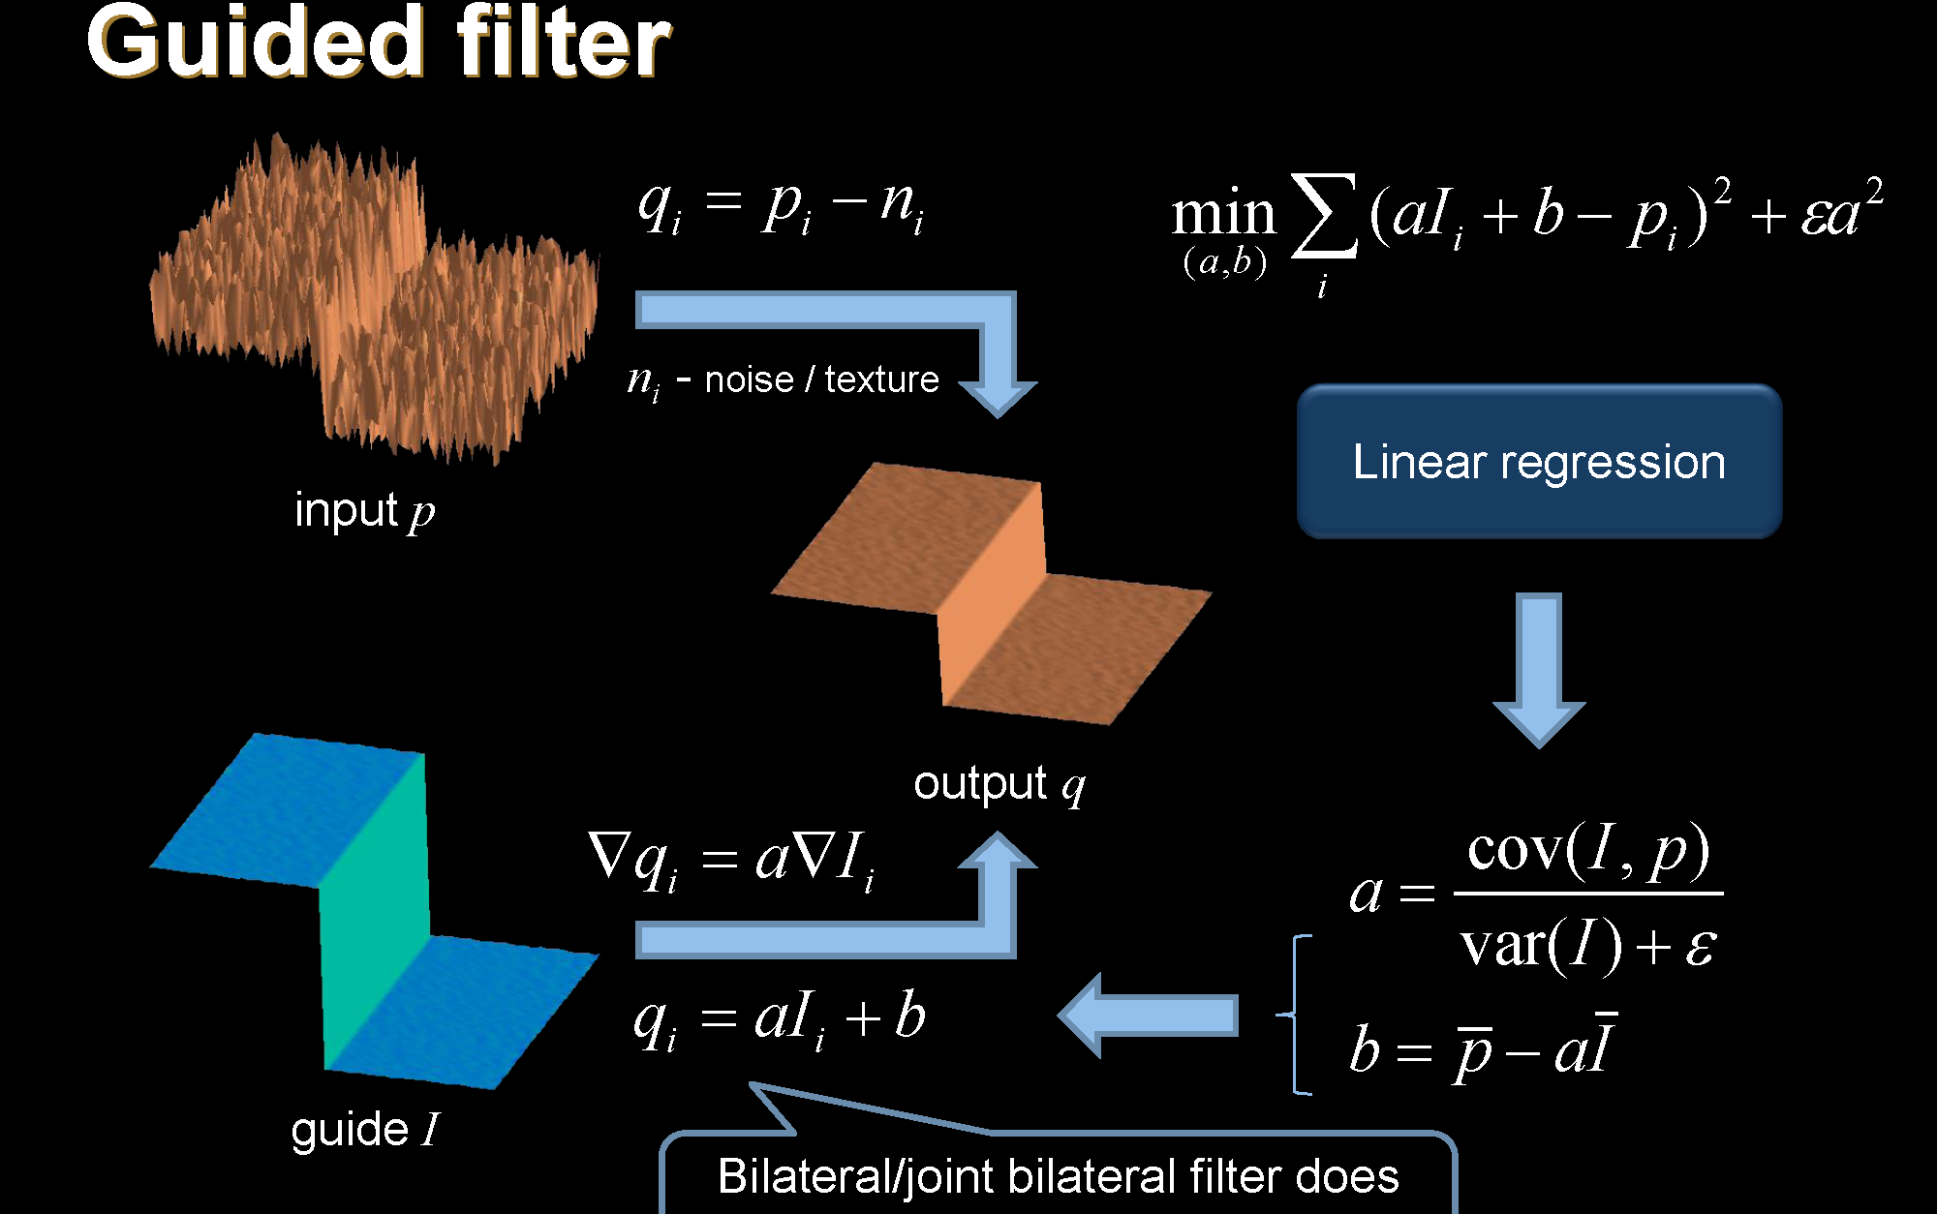

Slide 27
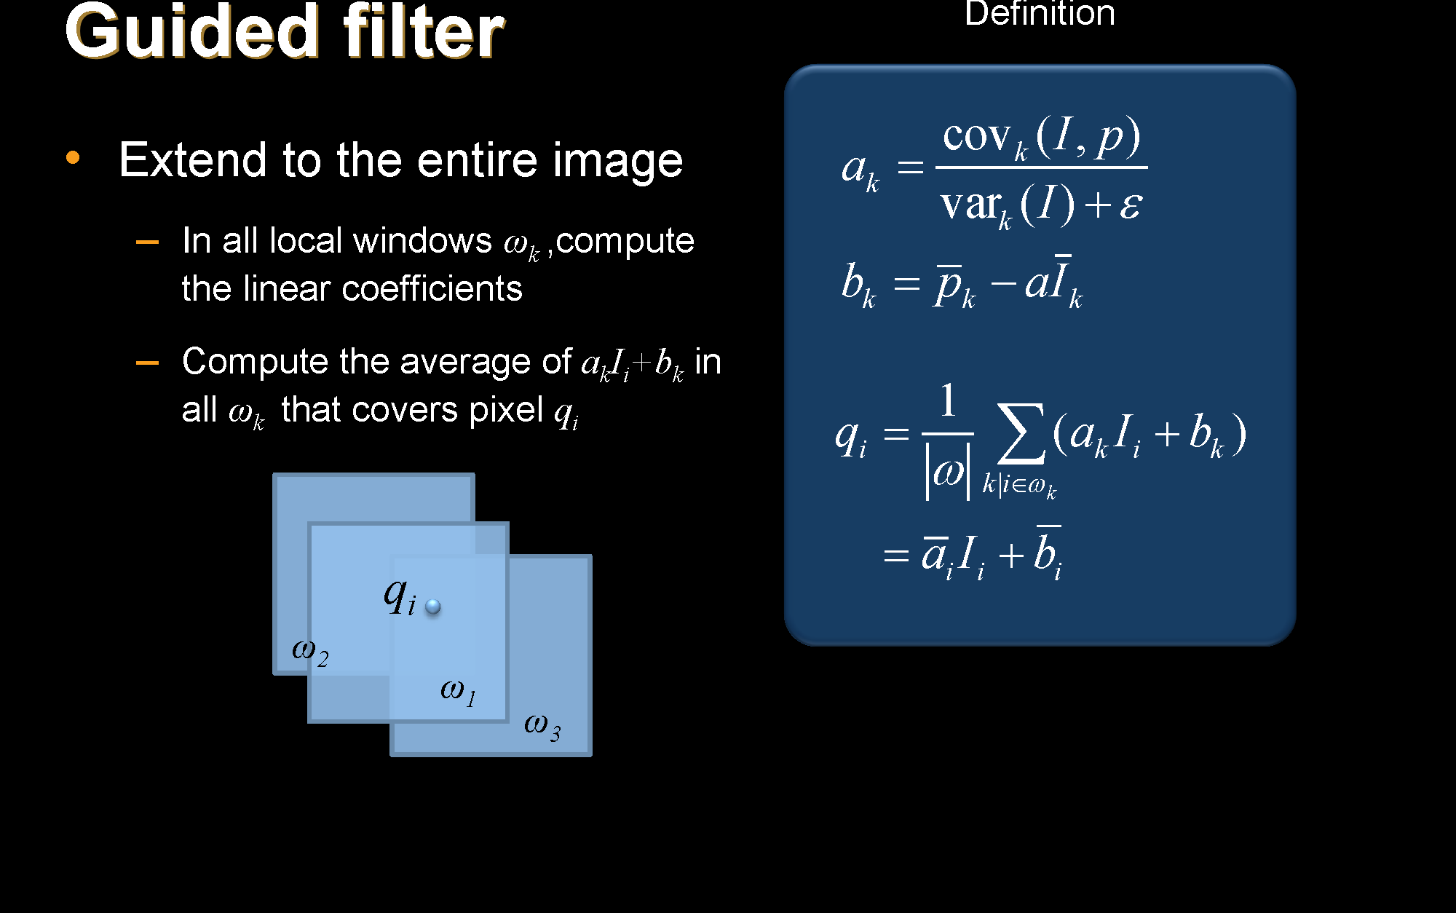

Slide 28
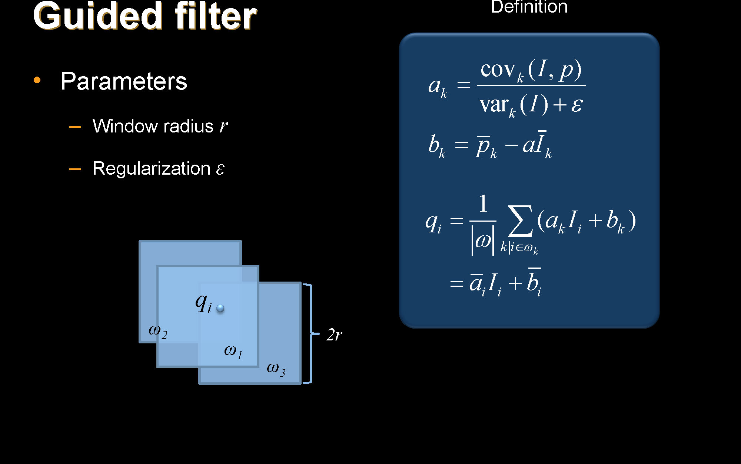

Slide 29
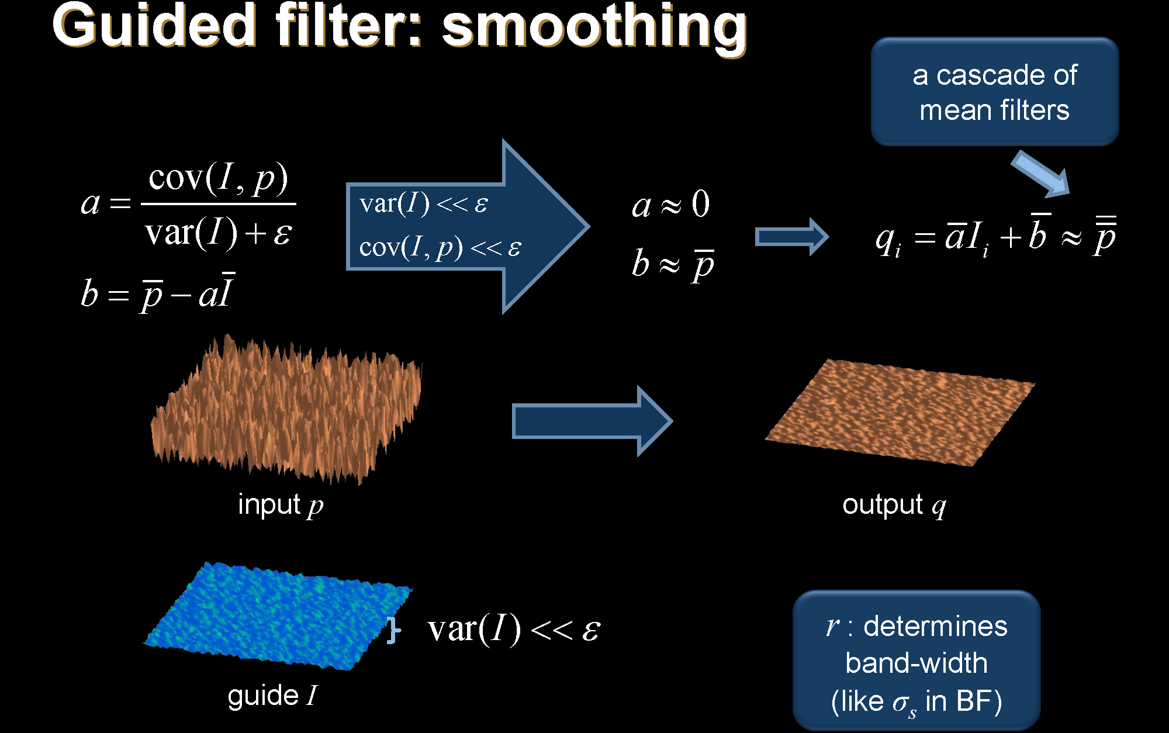

Slide 30
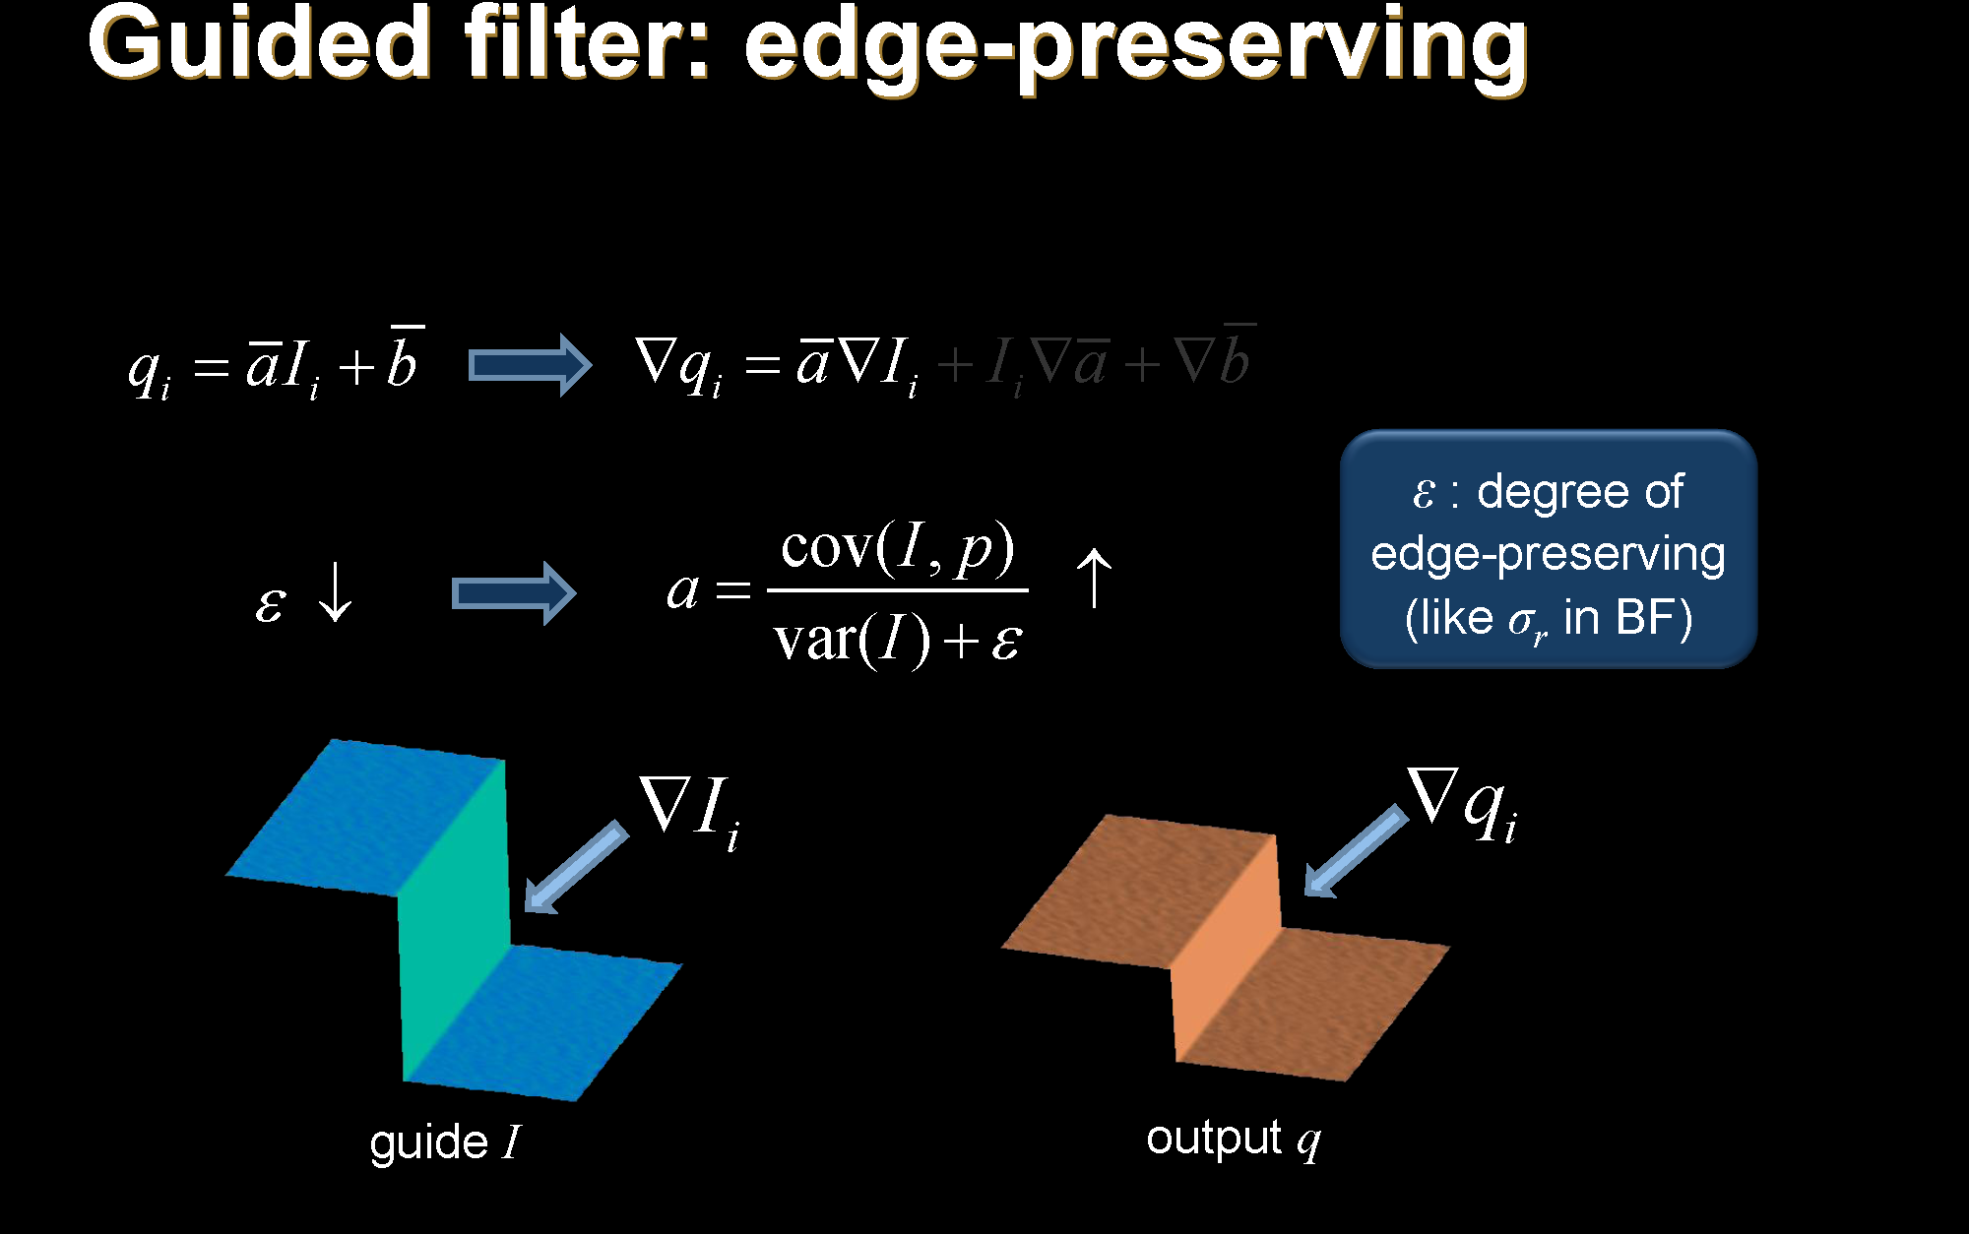

Slide 31
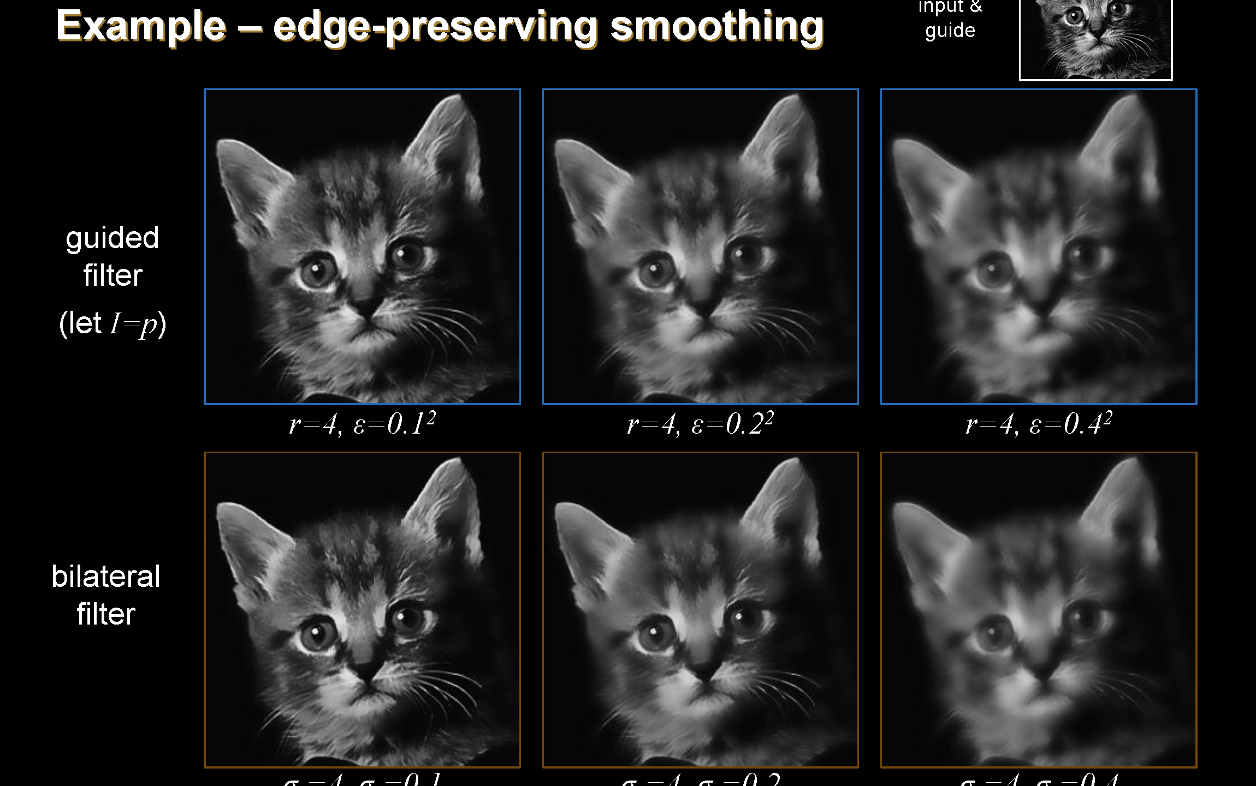

Slide 32
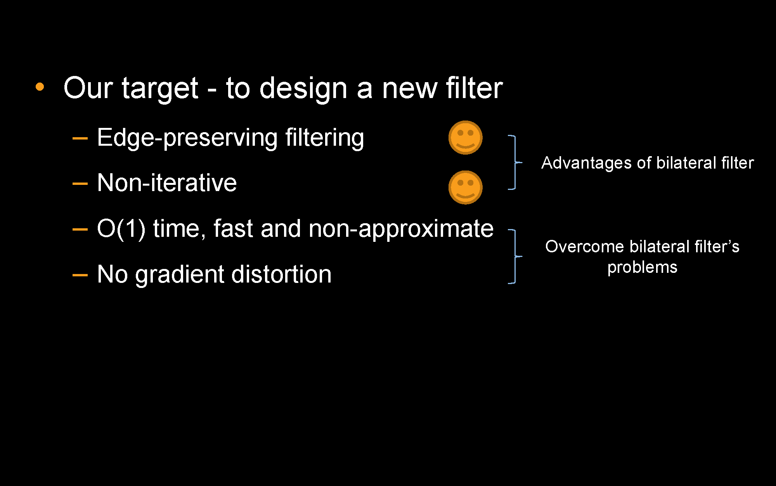

Slide 33
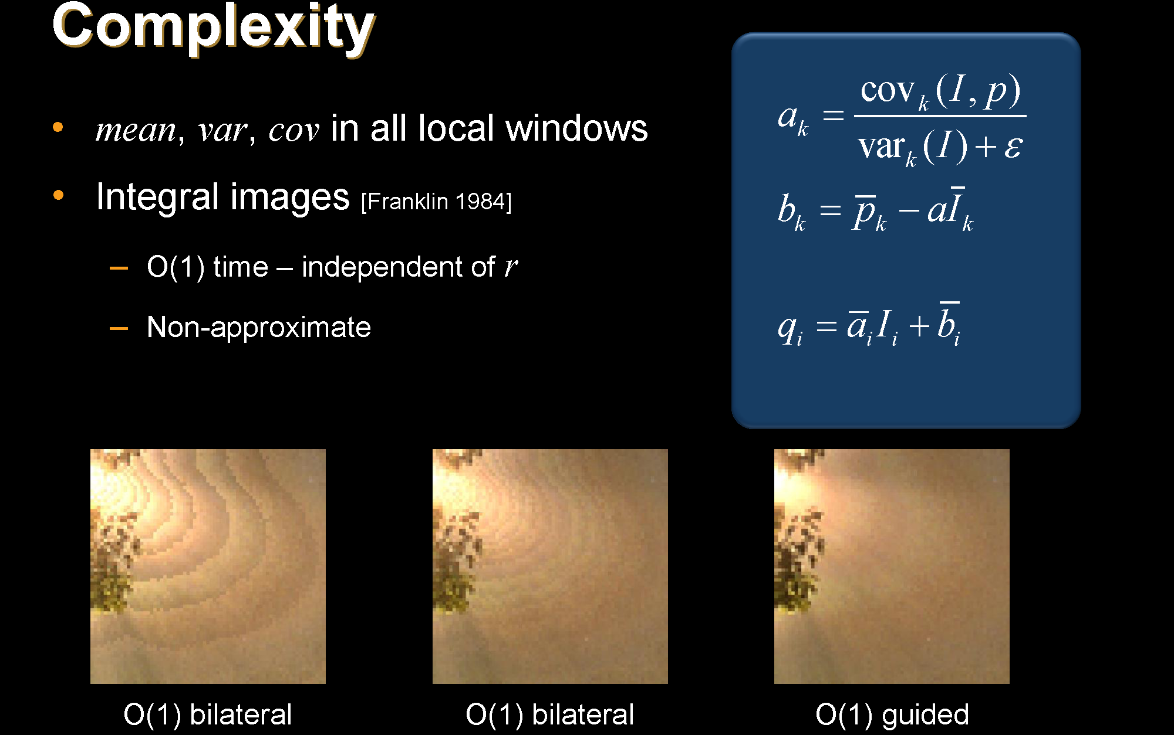

Slide 34
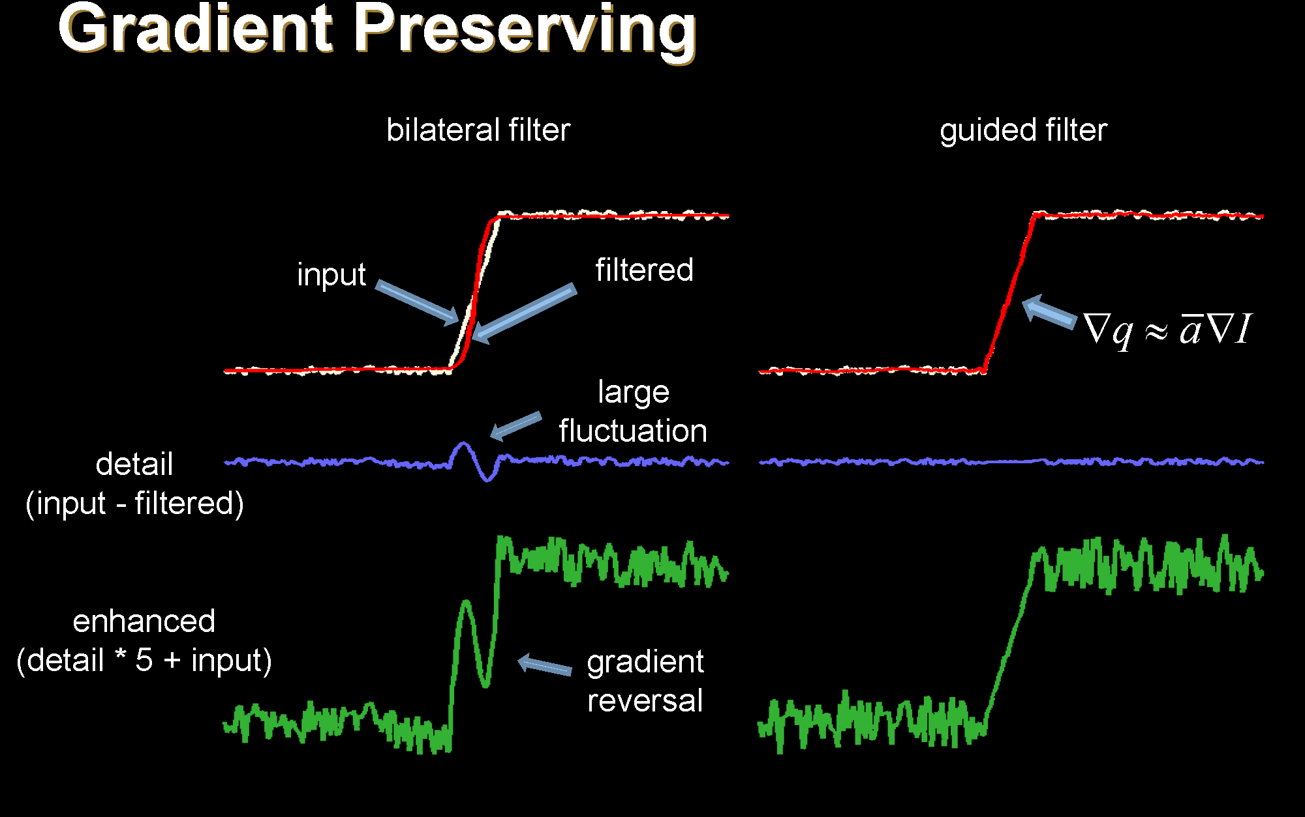

Slide 35
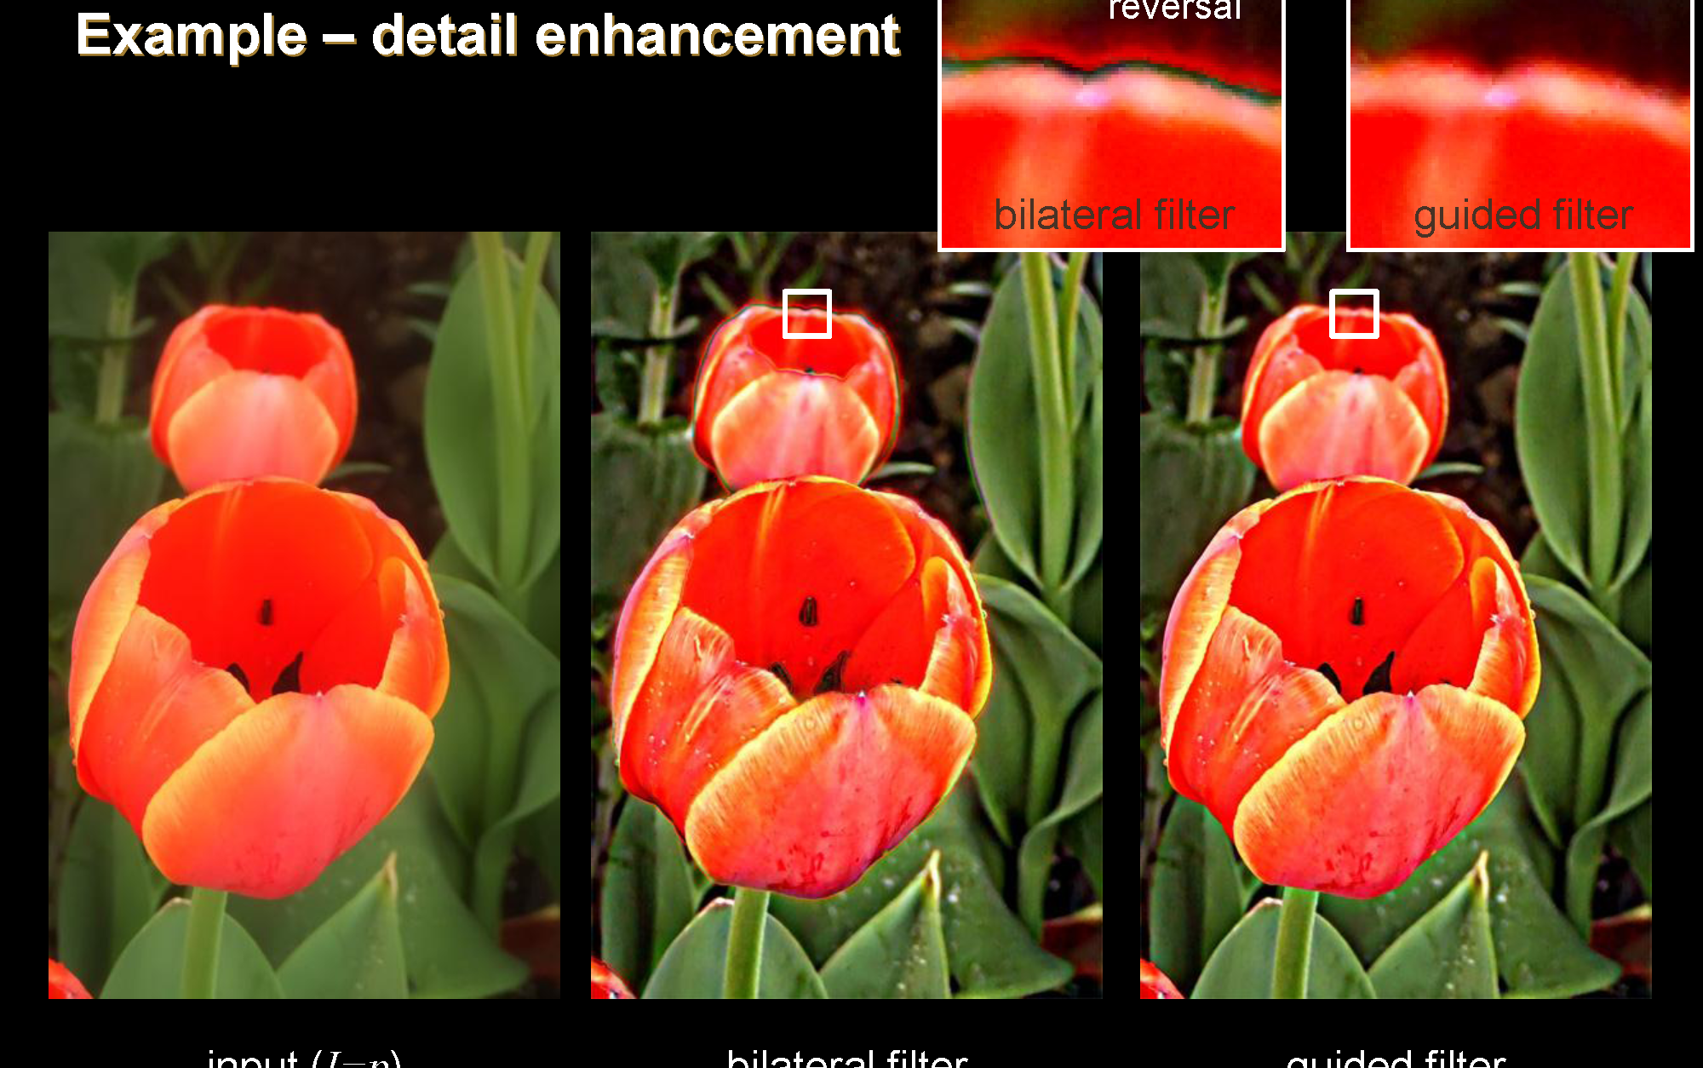

Slide 36
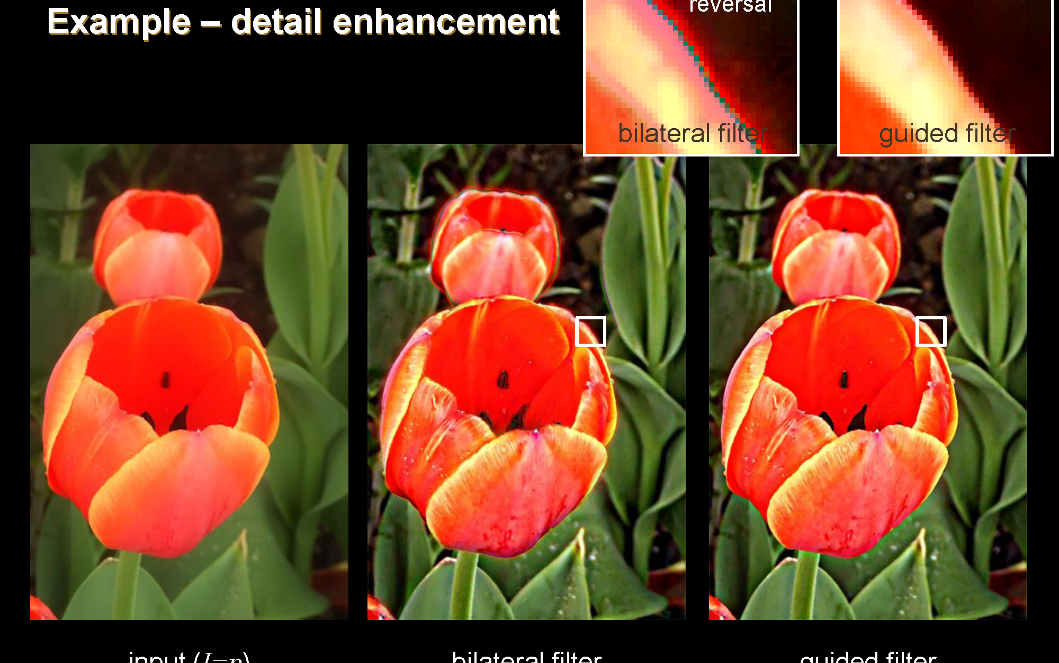

Slide 37
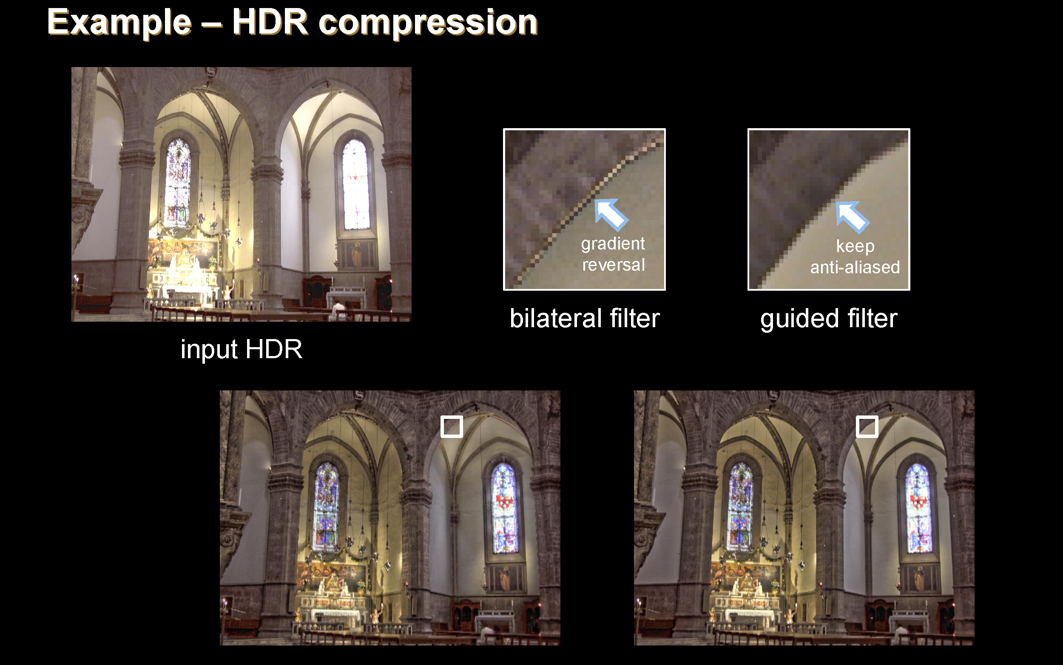

Slide 38
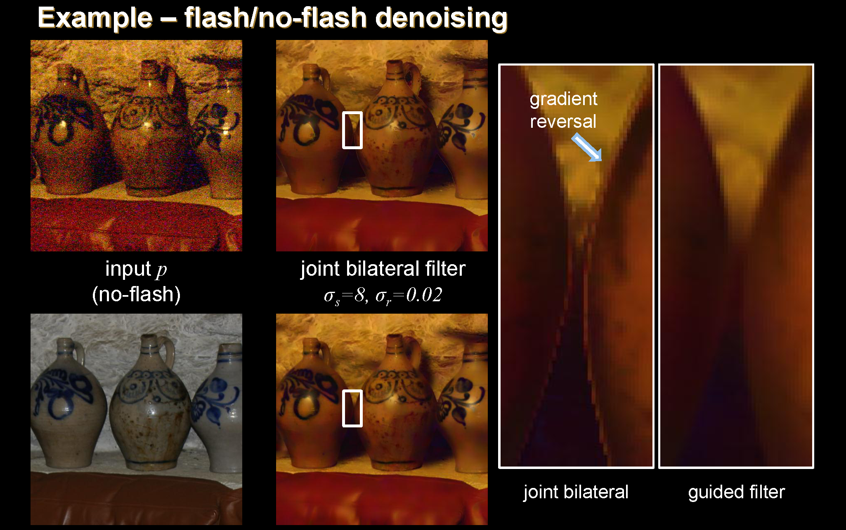

Slide 39
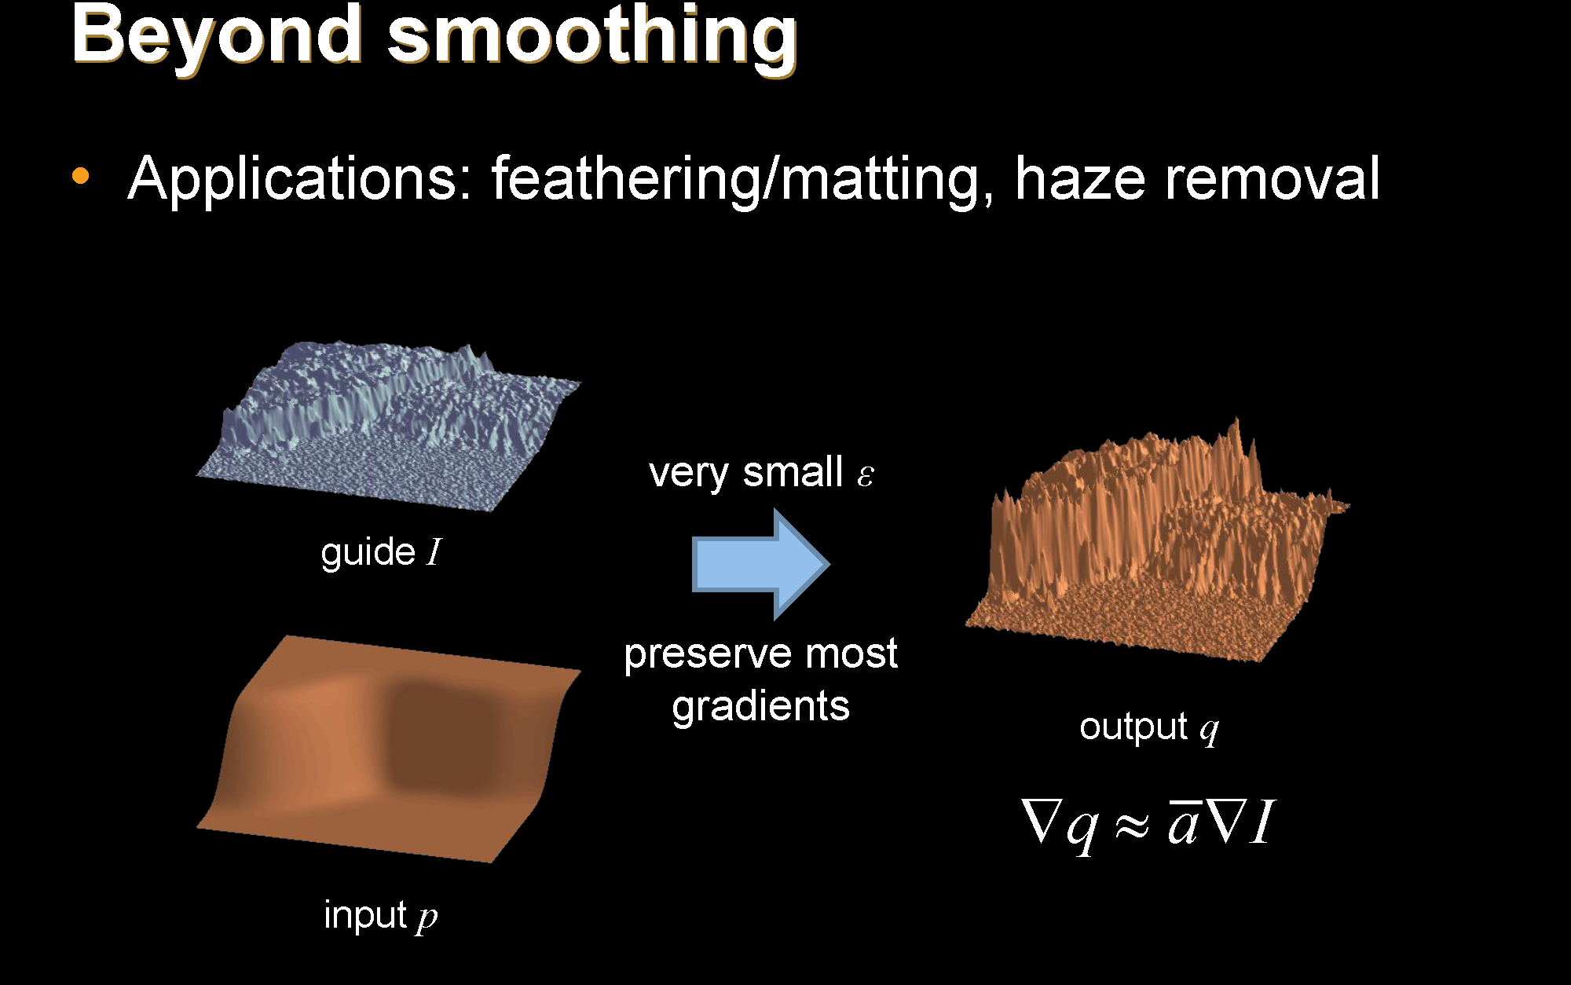

Slide 40
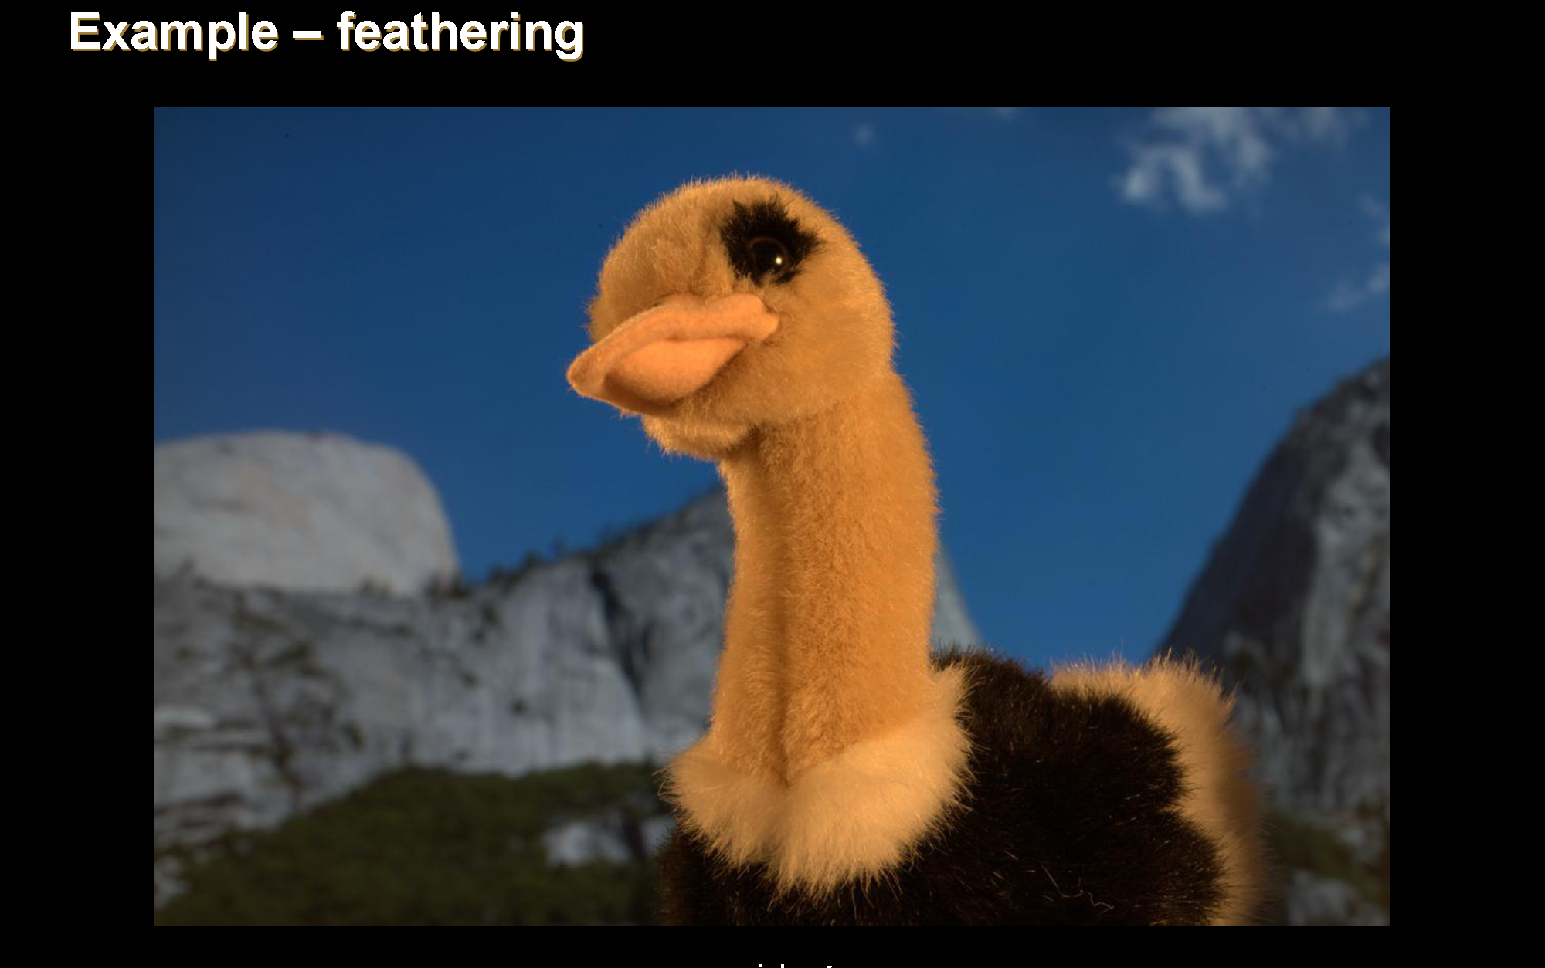

Slide 41
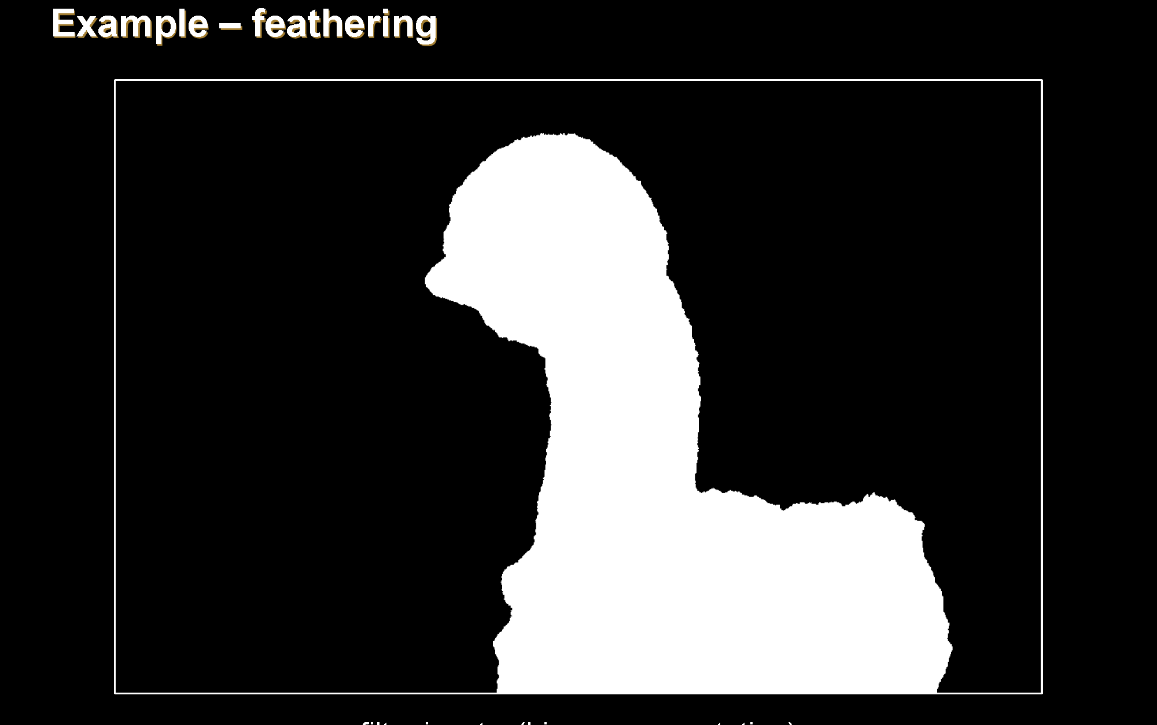

Slide 42


Slide 43
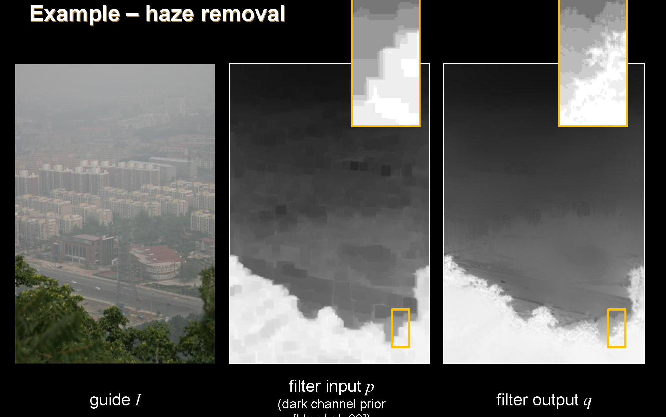

Slide 44
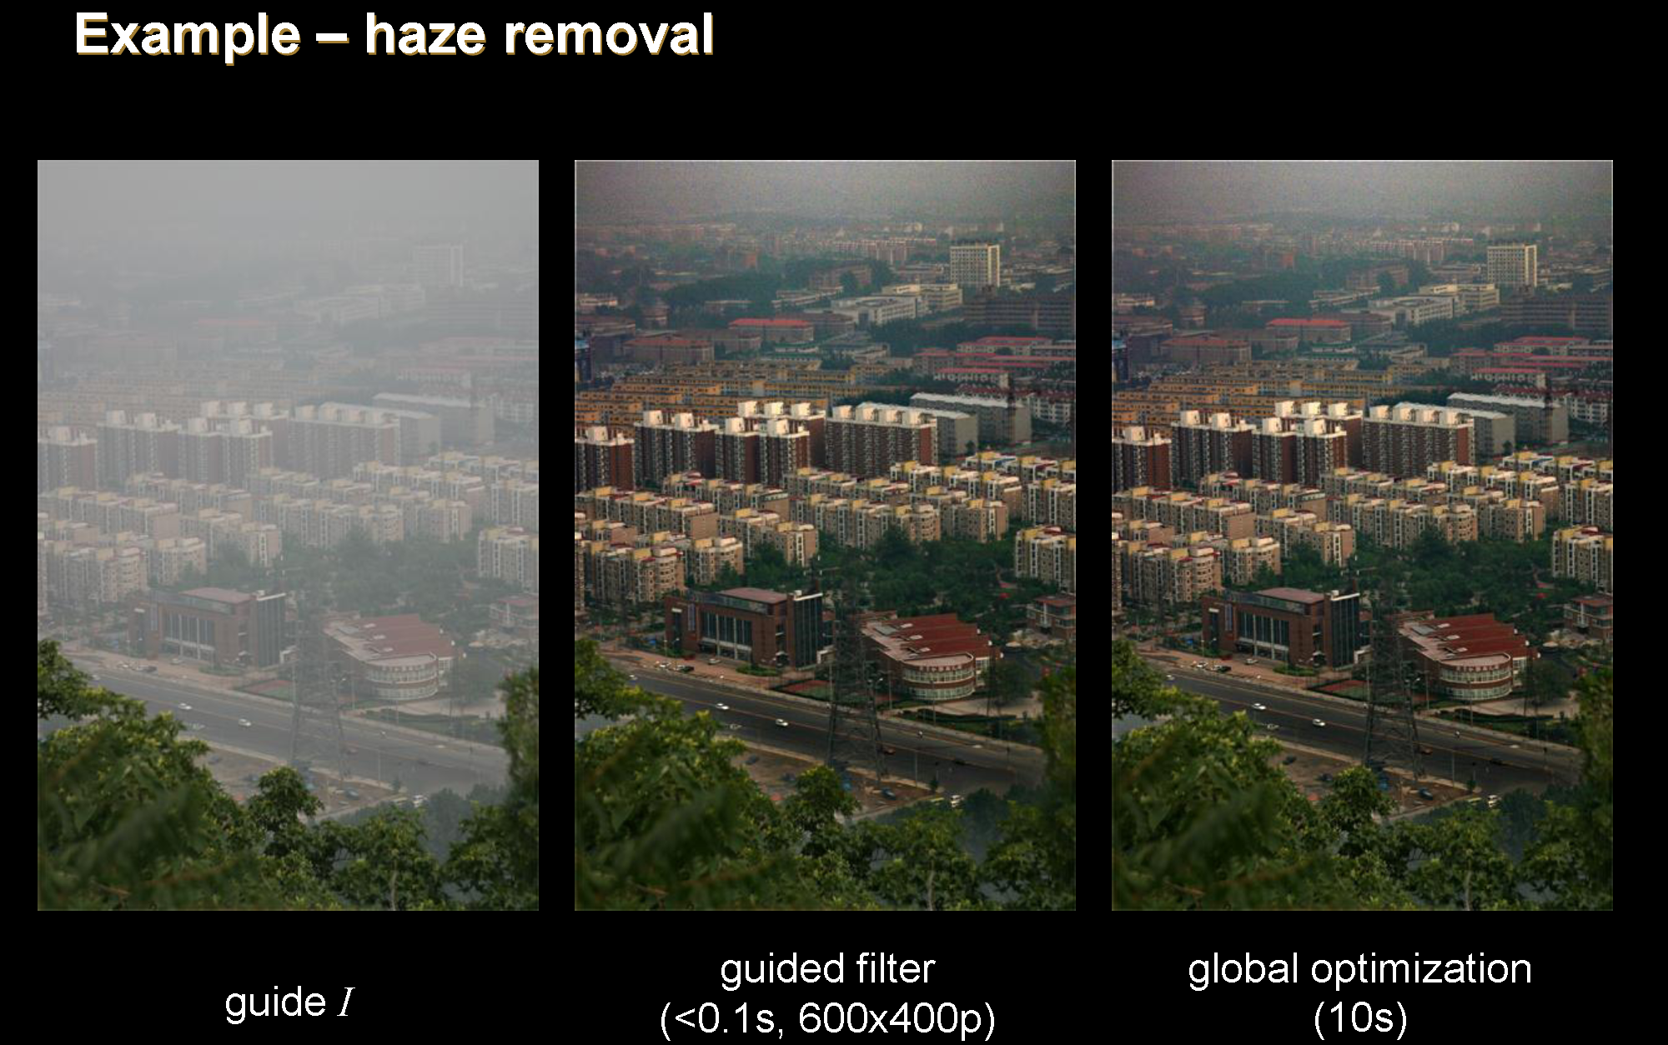

Slide 45
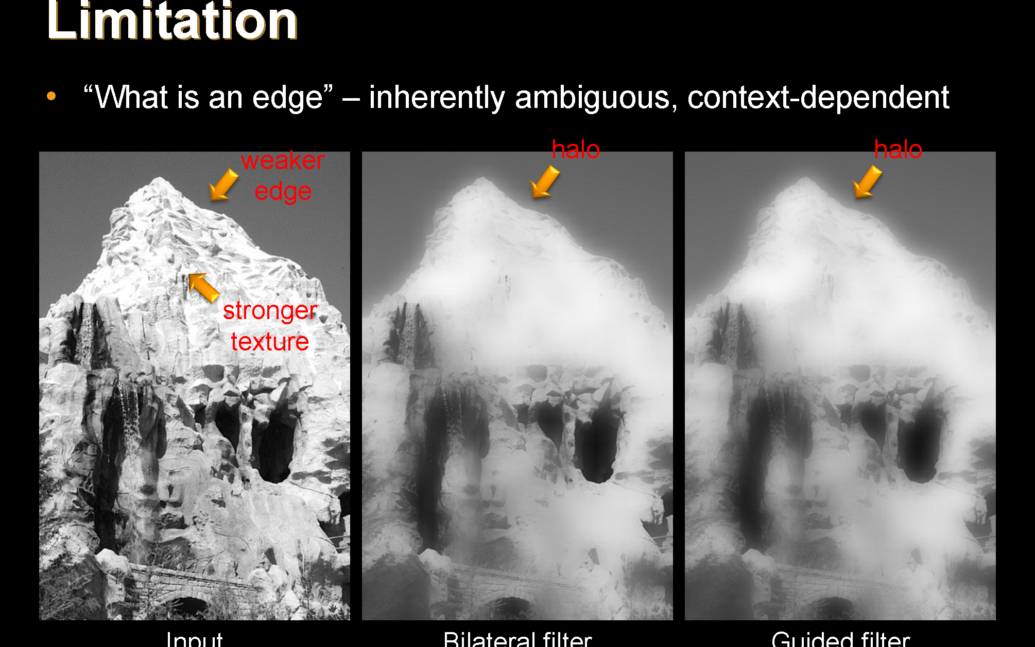

Slide 46
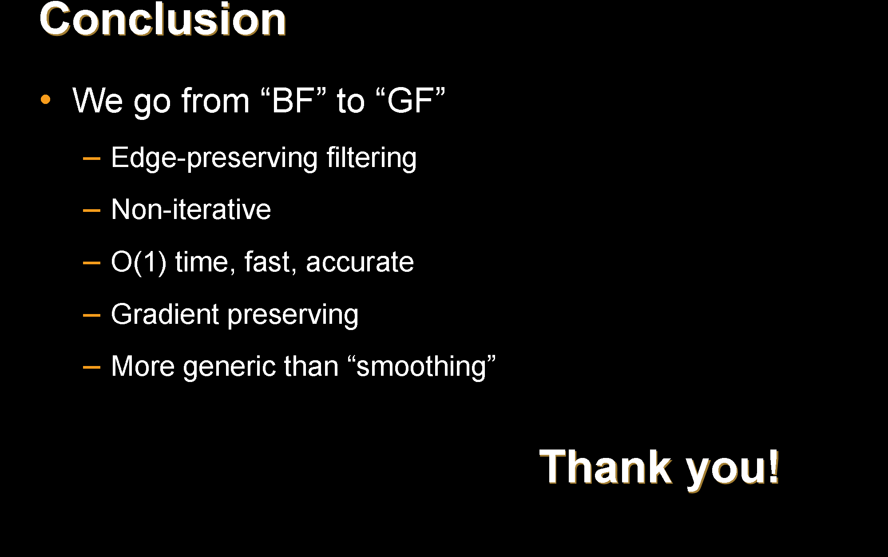

Slide 47
图像基本操作(VI)
Mingli Song
College of Computer Science, Zhejiang University
brooksong@zju.edu.cn
http://person.zju.edu.cn/msong/

Slide 48
Sparse Norm Filtering

Slide 49
Core Algorithm

Slide 50

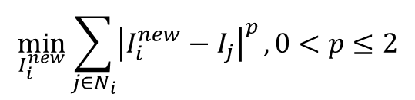

Introducing the Sparse Norm Filter (SNF)
The simplest way to smooth an image is to minimize the $l^{2}$ norm:
In order to let the filter be edge-preserving, we propose to change the norm into a sparser norm, and generalize into:
It is simple yet versatile.
$$\min_{I_{i}^{new}}{\sum_{j∈N_{i}}{{\left(I_{i}^{new}−I_{j}\right)}^{2}}}$$
→ Averaging Filter
$$\min_{I_{i}^{new}}{\sum_{j∈N_{i}}{{\left|I_{i}^{new}−I_{j}\right|}^{p}}}, 0<p≤2$$
→ Sparse Norm Filter

Slide 51
Applications

Slide 52

Application 1: Halo free filtering
Current filters
Weighted averaging filtering algorithms produce halos
Optimization based filtering algorithms are slow and sometimes produce unwanted results
The reason we can produce halo free results is that we can approximate the$l^{0}$energy.

Slide 53
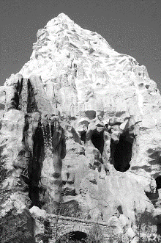


Original Image
Bilateral filter result using $σ_{s}=16, σ_{r}=0.4$

Slide 54


Original Image
Guided filter result using $r=16, ε={0.4}^{2}$

Slide 55
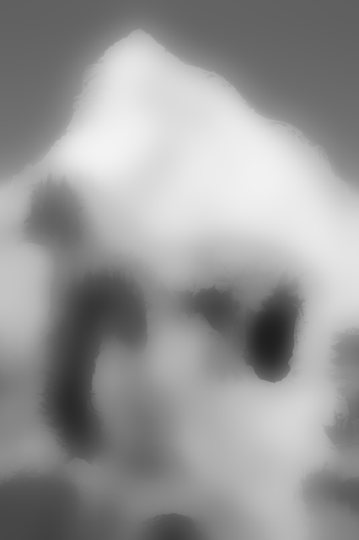

Original Image
Our result using $p=1.2, r=16$

Slide 56


Original Image
Our result using $p=0.05, r=16$

Slide 57

Application 2: Outlier tolerant filtering
SNF is a general class of filtering which includes median filter as a special case (the $l^{1}$ norm filter).

Slide 58
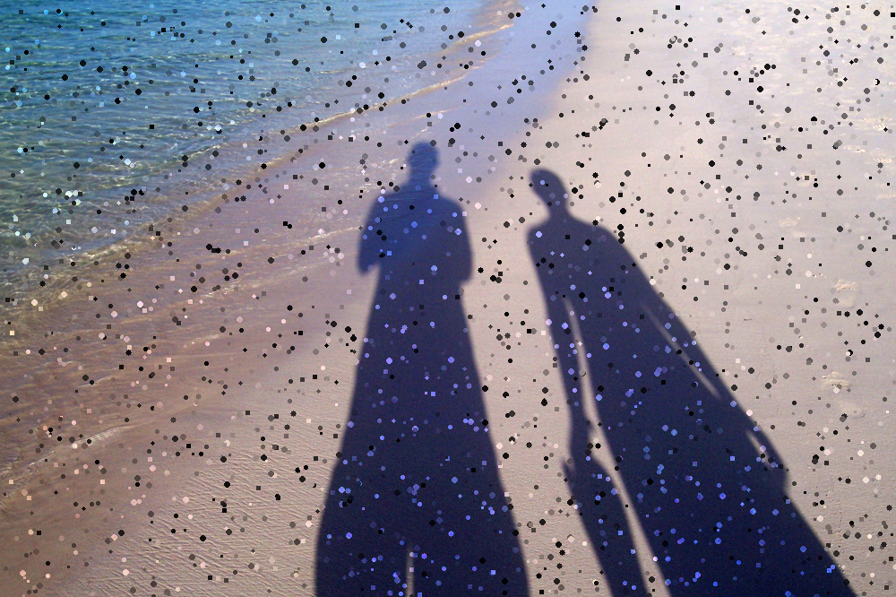
Input image

Slide 59
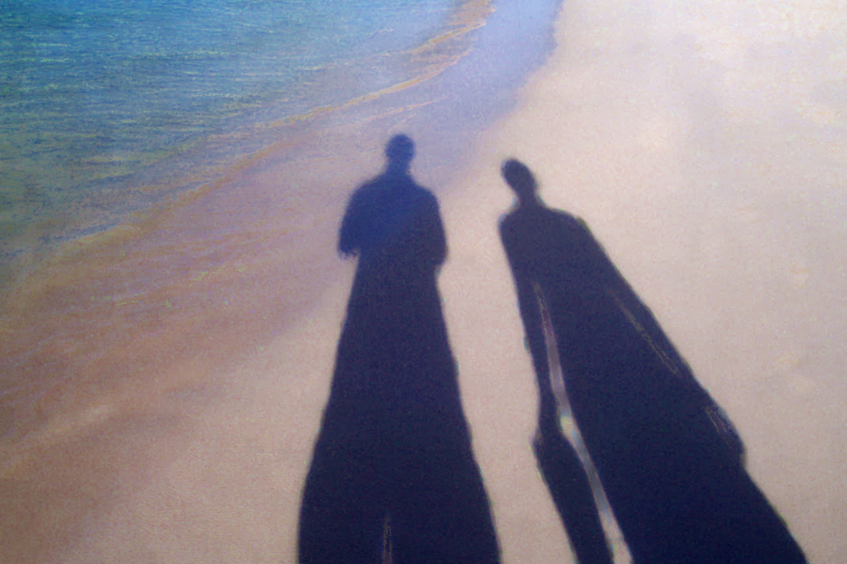

$l^{1}$ norm filter (the median filter)

Slide 60
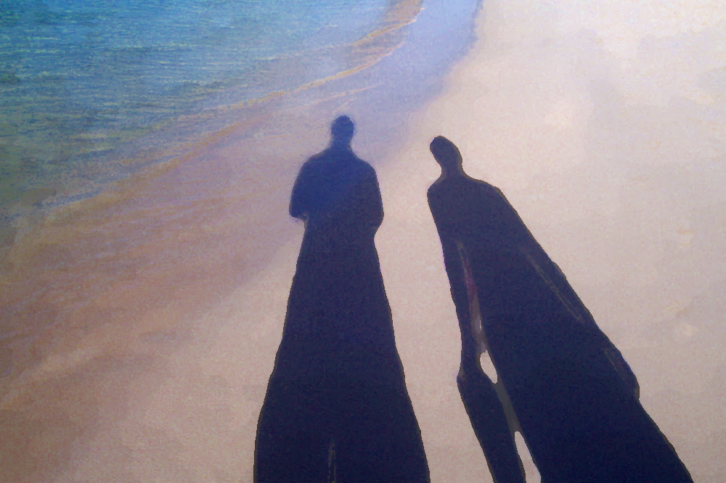

$l^{0.1}$ norm filter

Slide 61
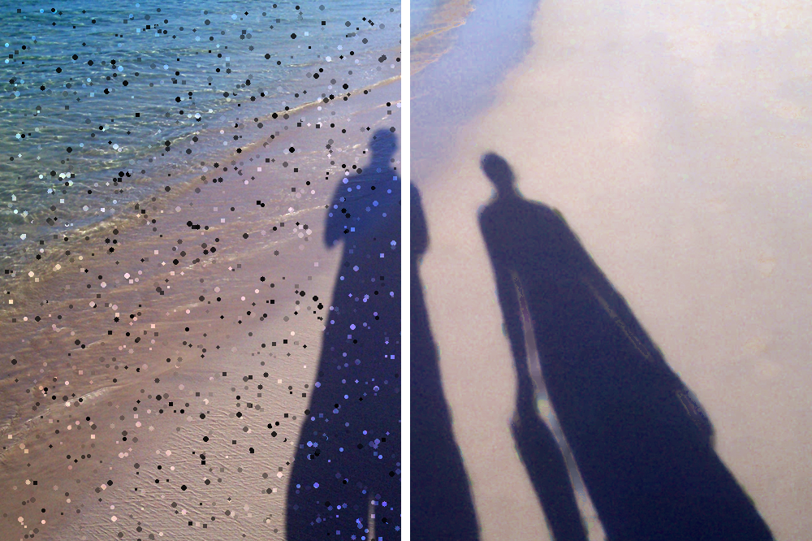
Before/After

Slide 62
Application 3: HDR Compression
Because the diffusion in SNF is non-local, it is less likely to be trapped as in gradient descent based algorithms.

Slide 63
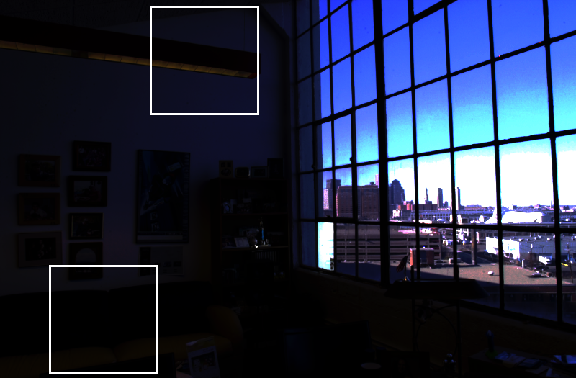


Original image
Zoom-in

Slide 64
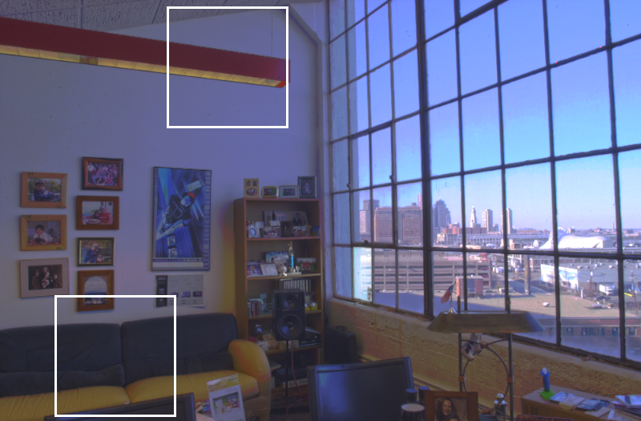
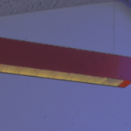
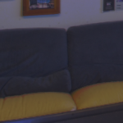
Result by Durand 02’
Zoom-in

Slide 65
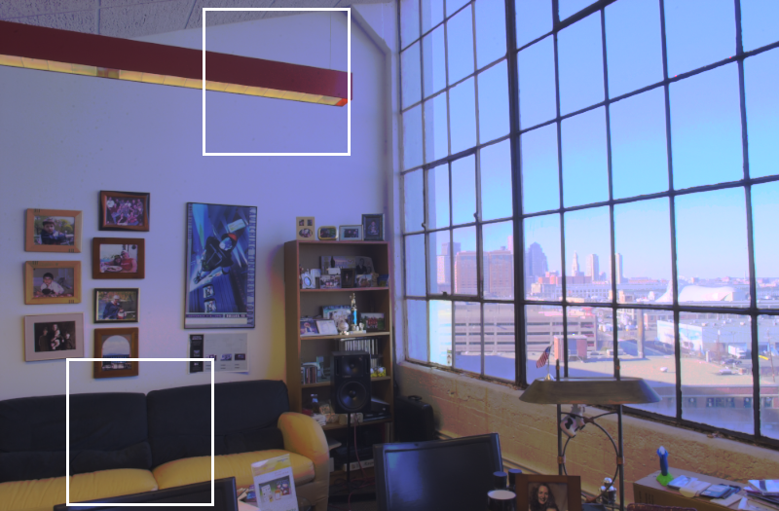
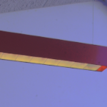
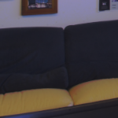
Result by Drago 03’
Zoom-in

Slide 66
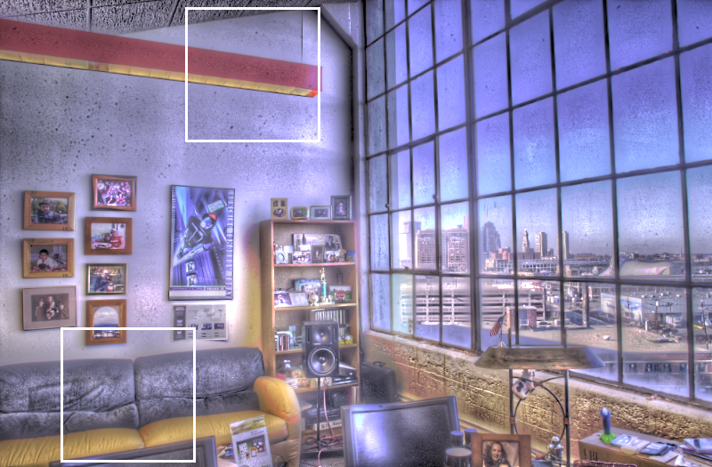
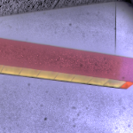
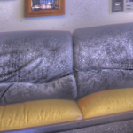
Result by Fattal 02’
Zoom-in

Slide 67
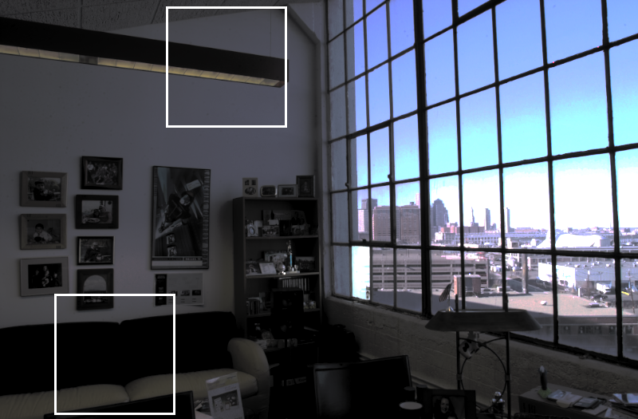


Result by Pattanaik 00’
Zoom-in

Slide 68
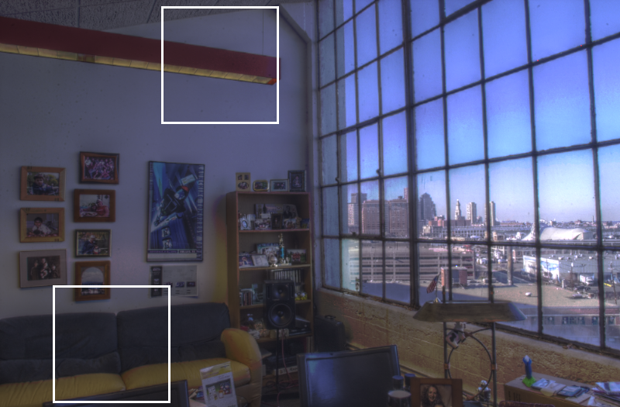
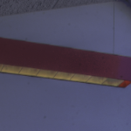
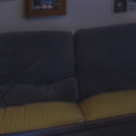
Result by Mantiuk 06’
Zoom-in

Slide 69



Result by Reinhard 05’
Zoom-in

Slide 70



Result by Farbman 08’ p=0.2
Zoom-in

Slide 71



Result by SNF p=0.2
Zoom-in

Slide 72
Application 4: Non-blind Deconvolution

Slide 73


Input blurry image
Estimated kernel

Slide 74

Result by Tikhonov regularization.
Estimated kernel

Slide 75

Result by sparse norm deconvolution using $p=0.5, r=5$
Estimated kernel

Slide 76
Application 5: Joint filtering
We can take another guidance image to provide guidance weight for filtering.

Slide 77


Noisy image
Flash image

Slide 78


Joint filtered image
Recolored image

Slide 79
Application 6: Segmentation
We can utilize joint filtering to accelerate normalized cut for image segmentation.
Replace matrix multiplication with efficient joint filtering in the eigensolver

Slide 80








Input image
Our result
Segments using $p=0.3, r=\frac{1}{16} of the image height$

Slide 81
We can extend the technique to normalized cut related algorithms.

Slide 82
Application 7: Colorization

Slide 83

Input gray scale image

Slide 84

Input color strokes

Slide 85

Result after 1 iter

Slide 86

Result after 3 iter

Slide 87

Result after 5 iter

Slide 88

Final result by SNF using $p=0.1,r=\frac{1}{4} of the image height$

Slide 89

Result by Levin 04’ [21]

Slide 90

Application 8: Seamless editing
Finally we extend the acceleration technique to $l^{2}$norm filtering.

Slide 91


Source image
Target image

Slide 92

Result by drag-and-drop

Slide 93

Result after 1 iter

Slide 94

Result after 3 iter

Slide 95

Result after 5 iter

Slide 96

Result after 7 iter

Slide 97

Final result by SNF

Slide 98


Slide 99
Thank you!

Slide 100
Assignment-6
1. Brute-force implementation of Bilateral Filter
Notes:
1.图像可视性对数增强
2.直方图
3.直方图均衡化

Slide 101
Basic Image Operation (VII) 图像基本操作(VII)
Mingli Song
College of Computer Science, Zhejiang University
brooksong@zju.edu.cn
http://eagle.zju.edu.cn/home/cv/songmingli/

Slide 102
Fourier and his work
Background of Fourier Transform
Fourier Transform
Discrete Fourier Transform (1D)
FFT
Discrete Fourier Transform (2D)
FFT for Image in Matlab

Slide 103

Joseph Fourier
Joseph’s father was a tailor in Auxerre
Joseph was the ninth of twelve children
His mother died when he was nine and
his father died the following year.
Fourier demonstrated talent on math
at the age of 14.
In 1787 Fourier decided to train for
the priesthood - a religious life or a
mathematical life?
In 1793, Fourier joined the local
Revolutionary Committee
Born: 21 March 1768 in Auxerre, Bourgogne, France Died: 16 May 1830 in Paris, France
Notes:
1768年3月21日生于欧塞尔，1830年5月16日卒于巴黎。9岁父母双亡， 被当地教堂收养。12岁由一主教送入地方军事学校读书。17岁（1785）回乡教数学，1794到巴 黎，成为高等师范学校的首批学员，次年到巴黎综合工科学校执教。1798年随拿破仑远征埃及时任军中文书和埃及研究院秘书，1801年回国后任伊泽尔省地方长官。1817年当选为科学院院士，1822年任该院终身秘书，后又任法兰西学院终身秘书和理工科大学校务委员会主席。

Slide 104
Fourier’s Work
Fourier did his important mathematical work on the theory of heat (highly regarded memoir On the Propagation of Heat in Solid Bodies ) from 1804 to 1807
This memoir received objection from Fourier’s mentors (Laplace and Lagrange) and not able to be published until 1815
Napoleon awarded him a pension of 6000 francs, payable from 1 July, 1815.
However Napoleon was defeated on 1 July and Fourier did not receive any money
Notes:
拉普拉斯曾任拿破仑的老师，所以和拿破仑结下不解之缘。拉普拉斯在数学上是个大师，在政治上是个小人物、墙头草，总是效忠于得势的一边，被人看不起，拿破仑曾讥笑他把无穷小量的精神带到内阁里。在席卷法国的政治变动中，包括拿破仑的兴起和衰落，没有显著地打断他的工作。尽管他是个曾染指政治的人，但他的威望以及他将数学应用于军事问题的才能保护了他，同时也归功于他显示出的一种并不值得佩服的在政治态度方面见风使舵的能力。
1799年出版了巨著《天体力学》的头两卷，主要论述行星运动、行星形状和潮汐。1802年出版第三卷，论摄动理论。 1805年出版第四卷，论木星四颗卫星的运动及三体问题的特殊解。1825年出版第五卷，补充前几卷的内容。由于这部巨著的出版，拉普拉斯被誉为法国的牛顿。据说，当拿破仑看到这部书时，问拉普拉斯，为何在他的书中一句也不提上帝。拉普拉斯明确地回答：「陛下，我不需要那个假设」.拿破崙將這句話告訴拉格朗日，拉格朗日卻說：「這是個好假設！它可以解釋許多事情」

Slide 105
Background of Fourier Transform
Many mathematicians tried to find a way to approximate a complex function by some simple functions for many years. Apart from the theoretical concern, this technique is invaluable for many practical applications.
Before the invention of differential calculus, this problem kept open.
Notes:
古今往来，众多数学家一直在寻找用简单函数较好地近似代替复杂函数的途径，除了理论上的需要外，它对实际应用的领域的意义更是不可估量。
在微积分发明之前，这个问题一直没有本质上的突破。

Slide 106
Expansion of a Function
Example (Taylor Series)
constant
first-order
term
second-order
term
…
British mathematician Taylor invented a method to represent one analytic function by infinite linear combination of power functions.
Notes:
英国数学家泰勒在17世纪找到了用幂函数的无限线性组合表示一般的解析函数的方法。

Slide 107


Fourier Series
Fourier series make use of the orthogonality relationships of
the sine and cosine functions
In the middle of 18th century, Fourier found that the infinite linear combination of trigonometric functions could represent a general function in a finite interval, when he was studying the heat propagation problem.
Notes:
18世纪中叶，法国数学家傅里叶在研究热传导问题时，找到了三角函数的无限线性组合表示有限区间上的一般函数的方法，即把函数展开成三角级数。

Slide 108



Sine function
——Simple periodic phenomena, simple harmonic vibration.
One periodic movement, can be decomposed into a combination of simple harmonic vibrations:
Notes:
简单的周期现象，简谐振动。
一个周期运动，物理学上可以分成若干个简谐振动的叠加：

Slide 109

Examples

Slide 110

Fourier Transform

Slide 111



Notes:
u( t ) 不同频率正弦波分量的叠加过程

Slide 112




Slide 113




Slide 114




Slide 115




Slide 116







Note:
Howto: periodic prolongation
Notes:
对于非周期函数,如果函数𝑓(𝑥)只在区间[−𝜋,𝜋] 上,也可展开成傅氏级数.
周期延拓

Slide 117
Importance
Just like Calculus invented by Newton, Fourier analysis is another mathematical tool
BIOM: fake iris detection
CS: anti-aliasing in computer graphics

Slide 118




FT in Biometrics

Slide 119


FT in CS
Anti-aliasing in 3D graphic display

Slide 120



Mathematical Background: Complex Numbers
A complex number x is of the form:
a: real part, b: imaginary part
Addition
Multiplication

Slide 121




Mathematical Background: Complex Numbers (cont’d)
Magnitude-Phase (i.e.,vector) representation
Magnitude:
Phase:
φ
Phase – Magnitude notation:

Slide 122


Mathematical Background: Complex Numbers (cont’d)
Multiplication using magnitude-phase representation
Complex conjugate
Properties

Slide 123



Mathematical Background: Complex Numbers (cont’d)
Euler’s formula
Properties

Slide 124



Mathematical Background: Sine and Cosine Functions
Periodic functions
General form of sine and cosine functions:

Slide 125



Mathematical Background: Sine and Cosine Functions
Special case: A=1, b=0, α=1
π
π

Slide 126




Mathematical Background: Sine and Cosine Functions (cont’d)
Shifting or translating the sine function by a const b
Note: cosine is a shifted sine function:

Slide 127

Mathematical Background: Sine and Cosine Functions (cont’d)
Changing the amplitude A

Slide 128

Mathematical Background: Sine and Cosine Functions (cont’d)
Changing the period T=2π/|α|
consider A=1, b=0: y=cos(αt)
α =4
period 2π/4=π/2
shorter period
higher frequency
(i.e., oscillates faster)
Frequency is defined as f=1/T
Alternative notation: sin(αt)=sin(2πt/T)=sin(2πft)

Slide 129

Image Transforms
Many times, image processing tasks are best performed in transformed domain other than the spatial domain.
Key steps:
(1) Transform the image
(2) Carry out the task(s) in the transformed domain.
(3) Apply inverse transform to return to the spatial domain.

Slide 130


Transformation Kernels
Forward Transformation
Inverse Transformation
forward transformation kernel
inverse transformation kernel

Slide 131

Continuous Fourier Transform (FT)
Transforms a signal (i.e., function) from the spatial domain to the frequency domain.
(IFT)
where

Slide 132


Example: Removing undesirable frequencies
noisy signal
frequencies
To remove certain
frequencies, set their
corresponding F(u)
coefficients to zero!
remove high
frequencies
reconstructed
signal

Slide 133


How do frequencies show up in an image?
Low frequencies correspond to slowly varying information (e.g., continuous surface).
High frequencies correspond to quickly varying information (e.g., edges)
Original Image
Low-passed

Slide 134

Example of noise reduction using FT
Notes:
8个白点，就是我们要去掉的频率

Slide 135

Frequency Filtering Steps

Slide 136

Discrete Fourier Transform (DFT) (cont’d)

Slide 137

Fast Fourier Transform（FFT）
Speed up the discrete Fourier Transform;
There are many repetitive work in the computation.
Cooley and Tukey presented in 1965:
Divide the original N-points sequence into several short sequence successively;
Compute the Discrete Fourier Transform of these short sequences;
Make up the wanted transform value;
Computational workload:
Notes:
加快离散傅立叶变换的速度
计算中有很多重复的内容
Cooley和tukey于1965年提出：
将原始的N点序列依次分解为一系列短序列；
求出这些短序列的离散傅立叶变换；
组合出所需的变换值；
计算量（乘除法）：

Slide 138




FFT Principle
Assuming N is the positive integral power of 2, we have
Notes:
假定N为2的正整数幂：

Slide 139






FFT Principle
Let：
then：

Slide 140


FFT Principle
and
Hence
Notes:
那如果取𝑀,𝑀+1,⋯,2𝑀−1怎么算？

Slide 141

意义：对一个长度为N的序列进行傅立叶变换可以通过将其分成两半计算，对第一部分的计算需要通过计算两个长度为N/2长度序列的傅立叶变换式进行，然后利用这两个长度为N/2的序列可以得到第二部分的值。
Notes:
意义：对一个长度为N的序列进行傅立叶变换可以通过将其分成两半计算，对第一部分的计算需要通过计算两个长度为N/2长度序列的傅立叶变换式进行，然后利用这两个长度为N/2的序列可以得到第二部分的值。

Slide 142
FFT in matlab
t = 0:0.001:0.6;
x = sin(2*pi*50*t)+sin(2*pi*120*t);
y = x + 2*randn(size(t));
figure; plot(1000*t(1:50),y(1:50)) ;
title('Signal Corrupted with Zero-Mean Random Noise') ;
xlabel('time (milliseconds)') ;

Slide 143
FFT in matlab
Y = fft(y,512);
Pyy = Y.* conj(Y) / 512;
f = 1000*(0:256)/512;
figure; plot(f,Pyy(1:257));
title('Frequency content of y');
xlabel('frequency (Hz)');

Slide 144


Extending FT in 2D
Forward FT
Inverse FT

Slide 145

Example: 2D rectangle function
FT of 2D rectangle function
2D sinc()

Slide 146

Extending DFT to 2D

Slide 147




Visualizing DFT
Typically, we visualize |F(u,v)|
The dynamic range of |F(u,v)| is typically very large
Apply stretching: (c is const.)
original image
before scaling
after scaling

Slide 148



magnitude
phase

Slide 149



Magnitude and Phase of DFT
What is more important?
Hint: use inverse DFT to reconstruct the image by magnitude or phase only information
magnitude
phase

Slide 150


Magnitude and Phase of DFT (cont’d)
Reconstructed image using
magnitude only
(i.e., magnitude determines the
contribution of each component!)
Reconstructed image using
phase only
(i.e., phase determines
which components are present!)

Slide 151


Magnitude and Phase of DFT (cont’d)
Notes:
女人
相位角度
只采用相位角度重建女人
只采用幅值重建女人
采用相位角度和右图方块提供的幅值重建女人
采用方块的相位角度和女人的幅值重建结果

Slide 152
FFT on image
Generate an image：
f = zeros(30,30);
f(5:24,13:17) = 1;
figure;
imshow(f,'InitialMagnification','fit');

Slide 153
FFT on image
FFT on the image：
F = fft2(f,256,256);
figure;
imshow(log(abs(F)));

